Slide 1
NEWBRINGOOTECH.COM

Slide 2
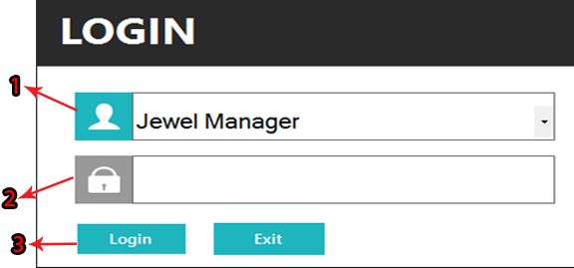
LOGIN
1. Enter your Username. 2. Enter your Password. 3. Click on login Button.

Slide 3
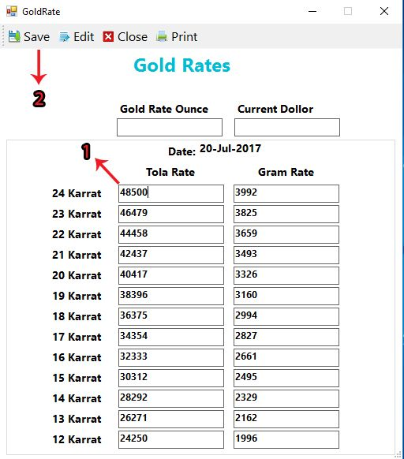
ADD GOLD RATE
1. You must enter new gold rate of the day when you login to software. 2. Click on save button to save gold rate.

Slide 4
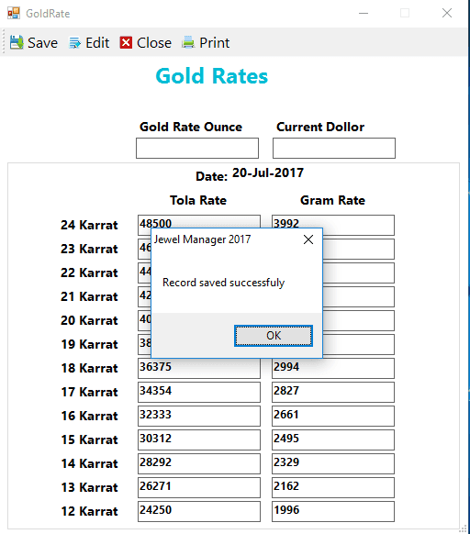
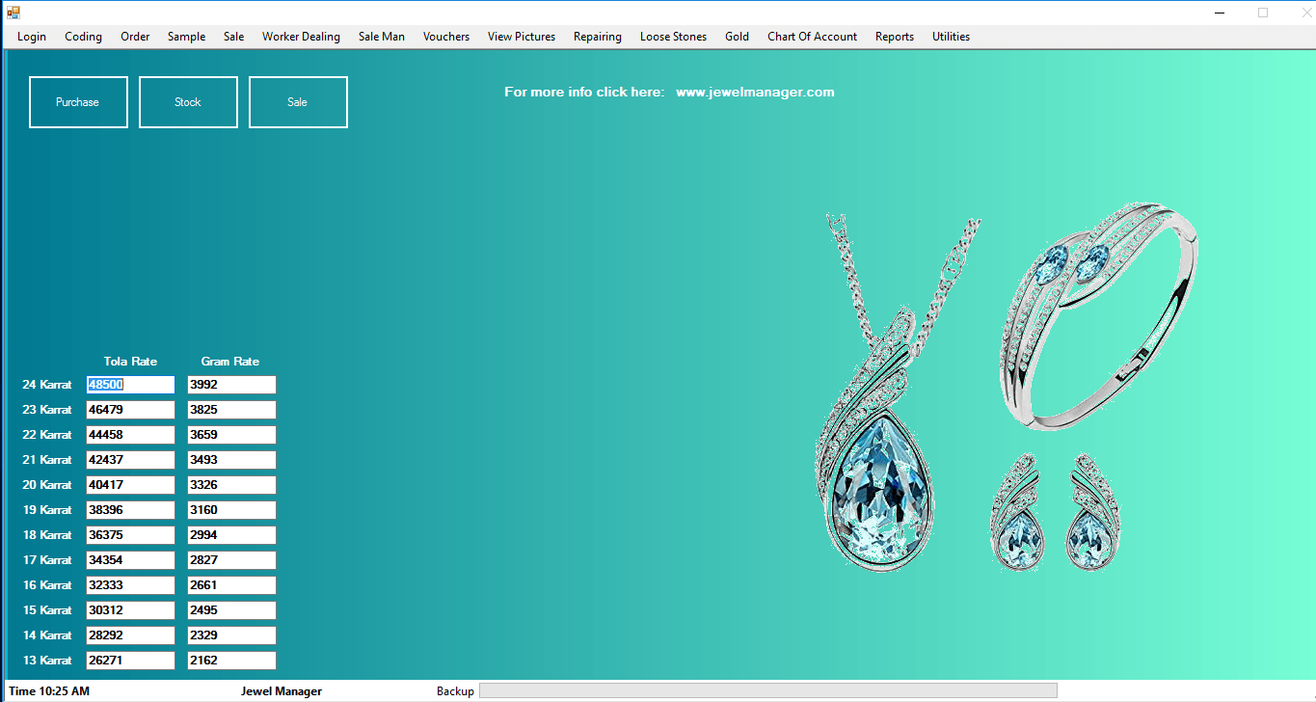

Slide 5
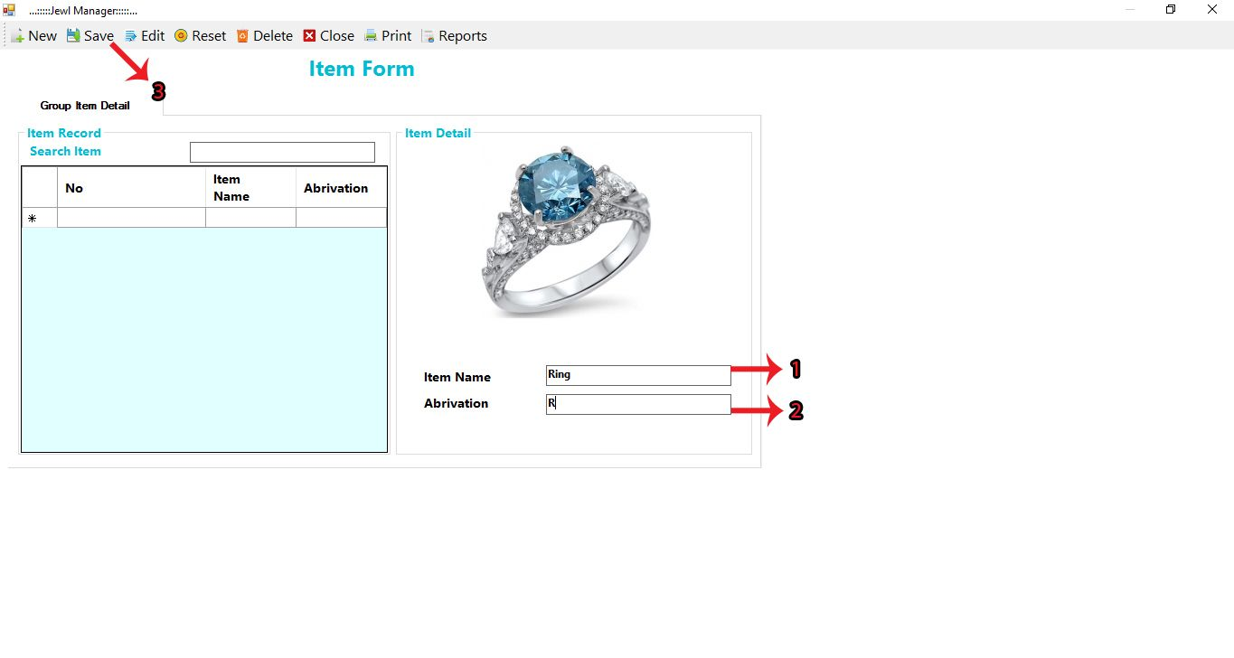
ADD ITEM
1. Enter Item name. 2. Enter Item’s abbreviation. 3. Click on save button to save Item

Slide 6
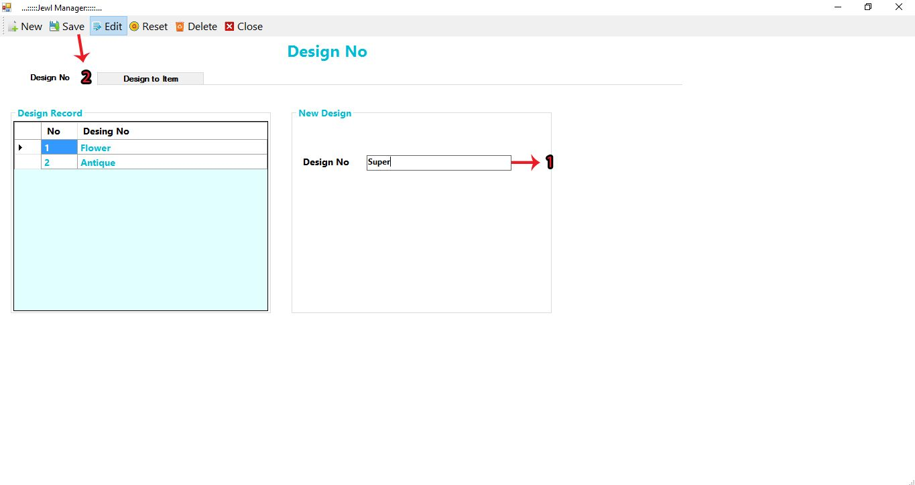
ADD DESIGN NUMBER-1
1. Enter design number. 2. Click on save button to save record.

Slide 7
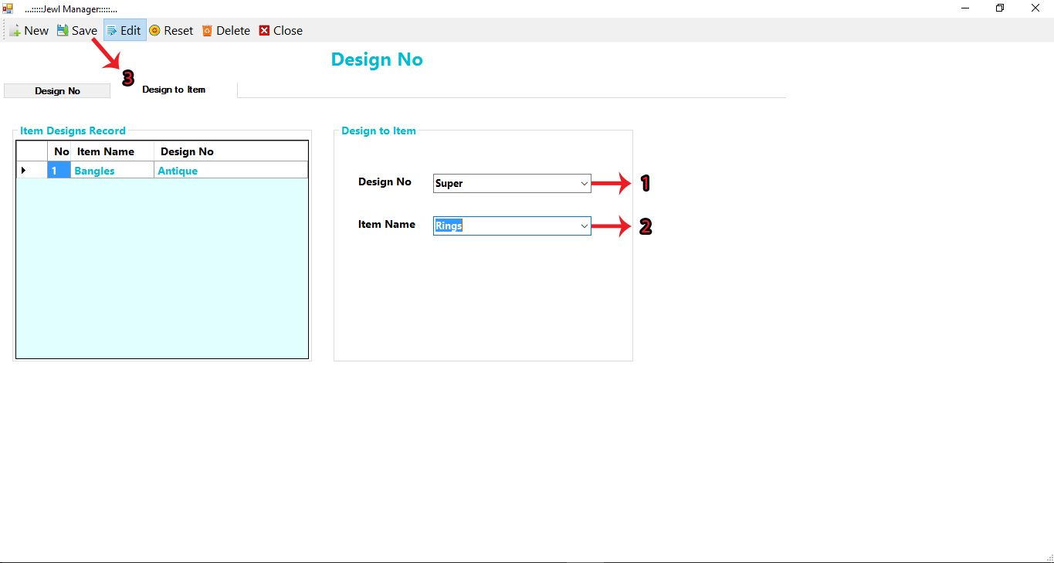
ADD DESIGN NUMBER-2
1. Select design number. 2. Select item name. 3. Click on save button to save record.

Slide 8
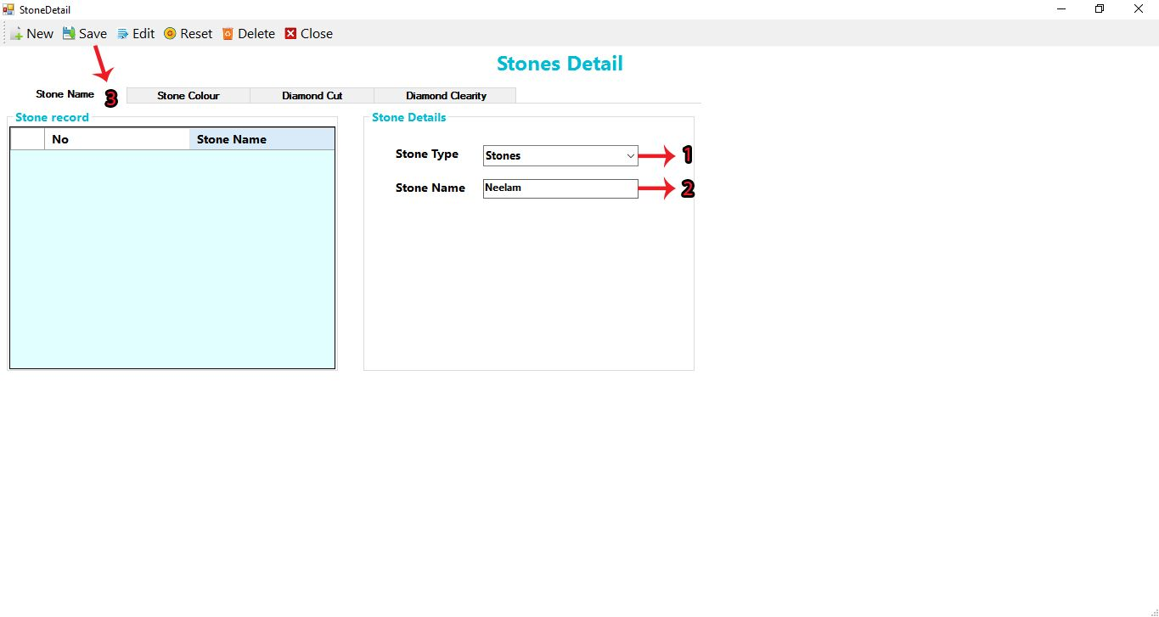
ADD STONE NAME-1
1. Select Stone Type. 2. Enter Stone Name. 3. Click on SAVE button to save the record.

Slide 9
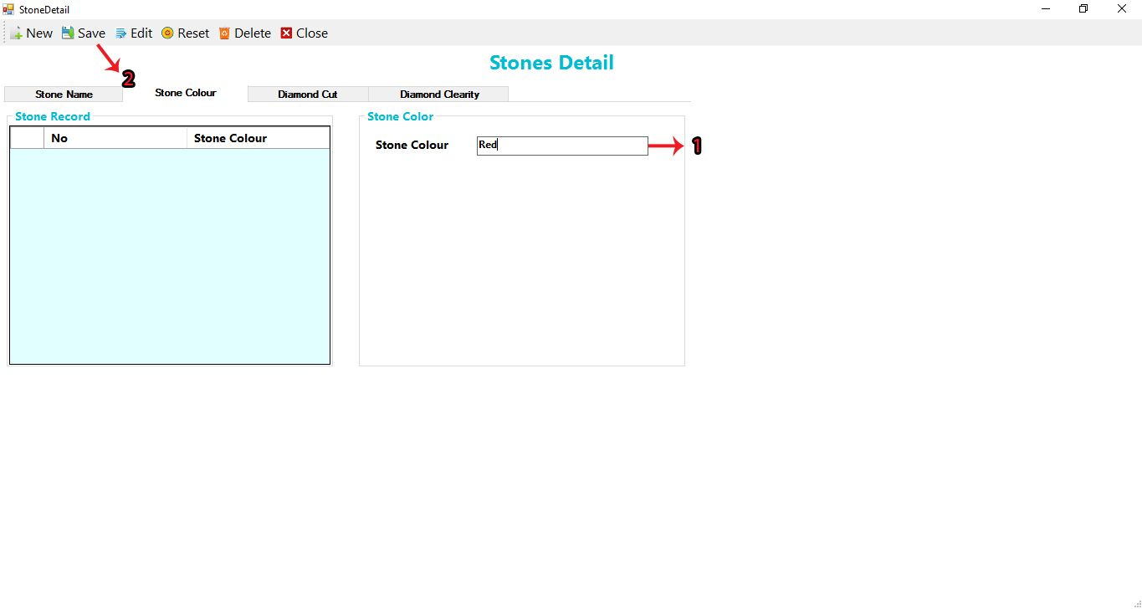
ADD STONE COLOR-2
1. Enter Stone Color. 2. Click on SAVE button to save the record.

Slide 10
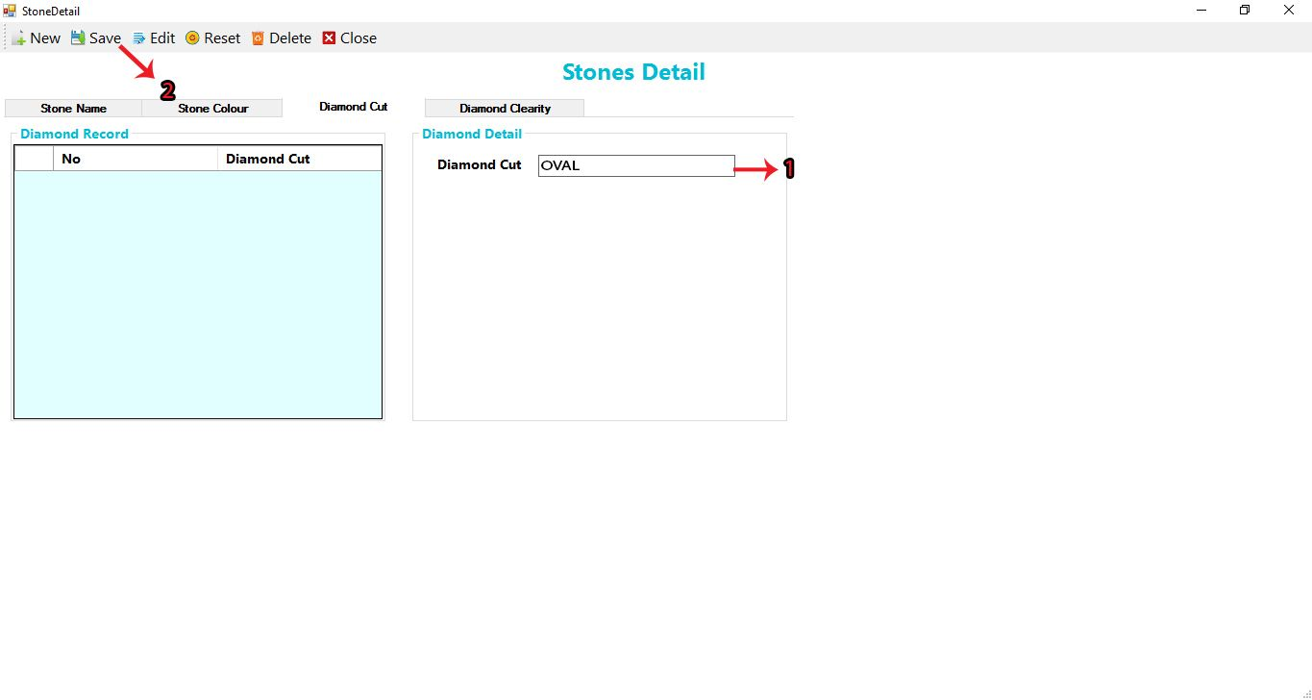
ADD DIAMOND CUT-3
1. Enter Diamond Cut Number. 2. Click on SAVE button to save the record.

Slide 11
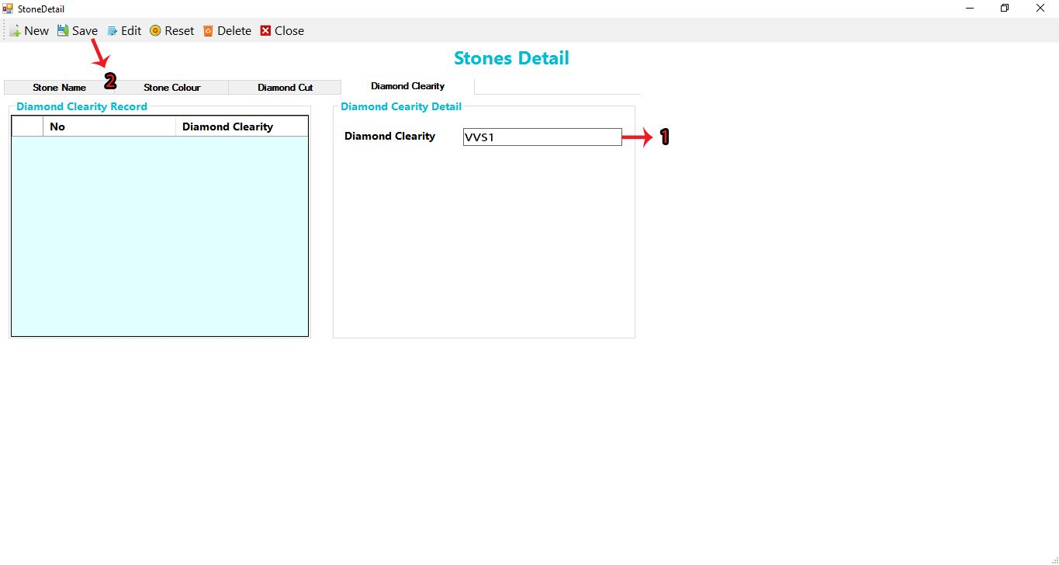
ADD DIAMOND CLARITY-4
1. Enter Diamond Clarity Number. 2. Click on SAVE button to save the record.

Slide 12
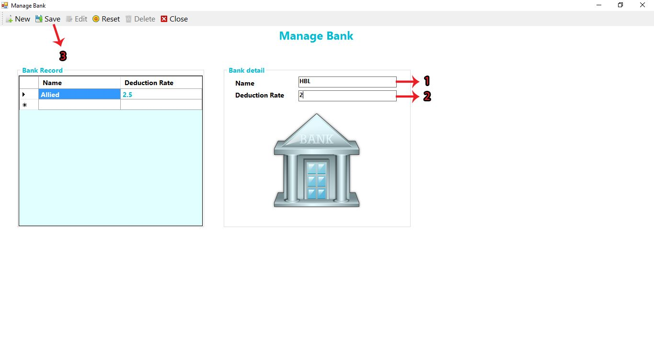
ADD BANK
1. Enter Name of bank. 2. Enter Deduction Rate. 3. Click on SAVE button to save the record.

Slide 13
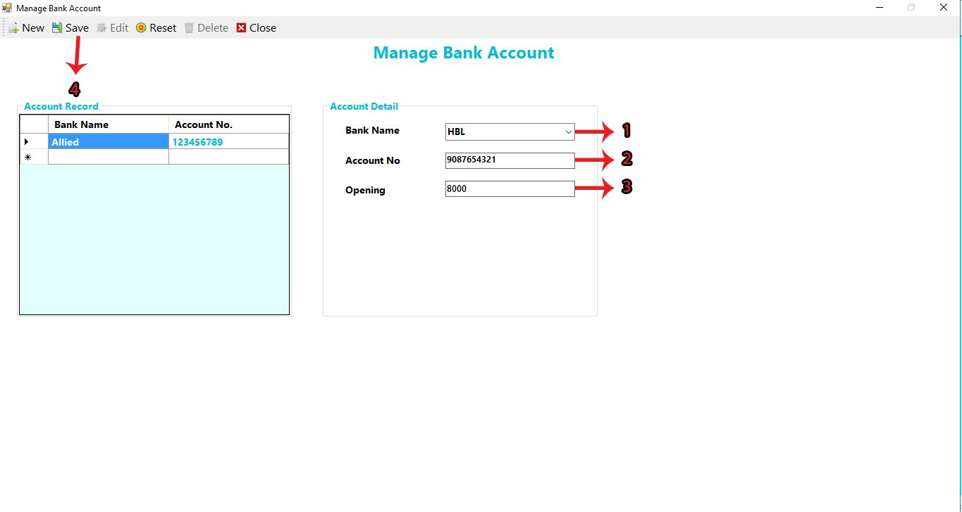
ADD BANK ACCOUNT
1. Select Bank Name. 2. Enter Account Number. 3. Enter Opening time. 4. Click on SAVE button to save the record.

Slide 14
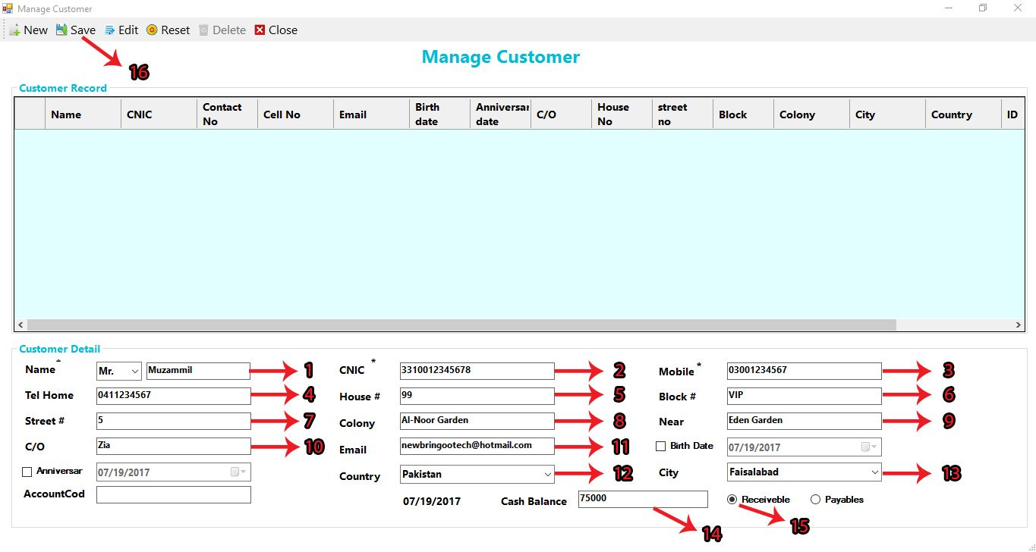
ADD CUSTOMER FORM
1. Enter customer’s Name. 2. Enter customer’s CNIC. 3. Enter customer’s Mobile Number. 4. Enter customer’s telephone of home if you want. 5. Enter House Number. 6. Enter Block Number or Name. 7. Enter customer’s street Number. 8. Enter customer’s Colony Name. 9. Enter the name of famous place near the customer’s colony. 10. Enter customer’s reference name. 11. Enter customer’s Email. 12. Enter customer’s country. 13. Enter customer’s city. 14. Enter Cash Balance of the customer which is receiveable or payable by customers. 15. Click on receivable if you want to receive the balance from customers OR Click on Payable if you will give the balance to the customers. 16. Now Click on SAVE button and your customer’s record will be saved.

Slide 15
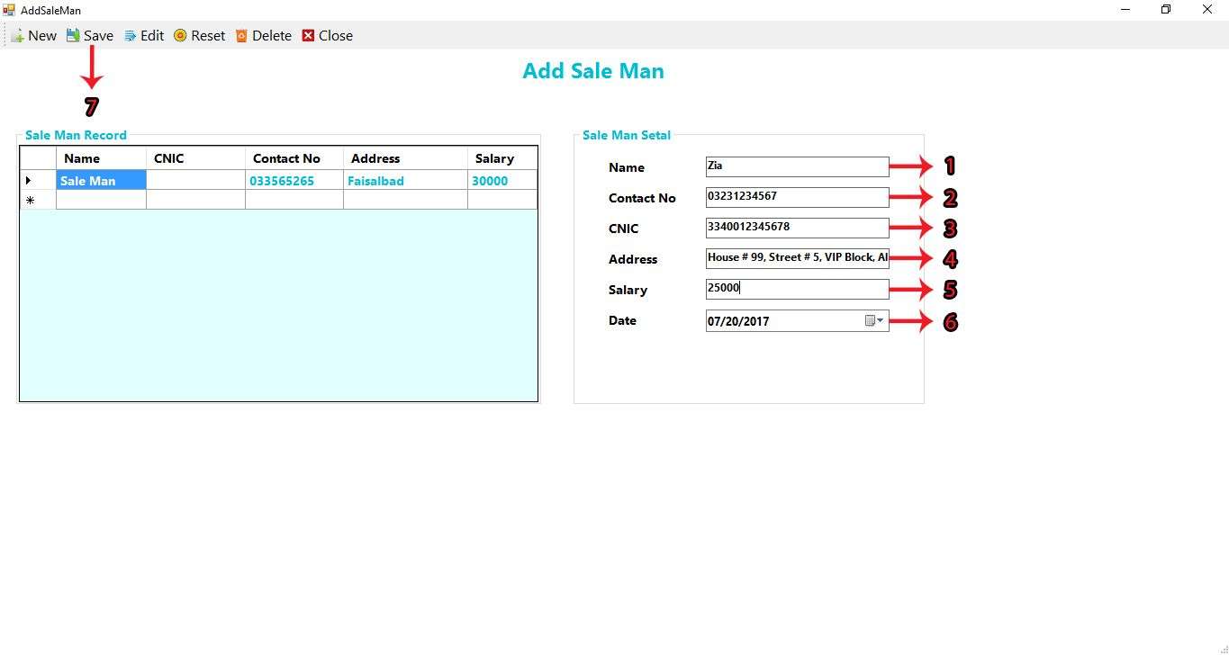
ADD SALE MAN
1. Enter Name of sale man. 2. Enter Contact No of sale man. 3. Enter CNIC of sale man. 4. Enter Address of sale man. 5. Enter Salary of sale man. 6. Select Date of joining of sale man. 7. Click on SAVE button to save the record.

Slide 16
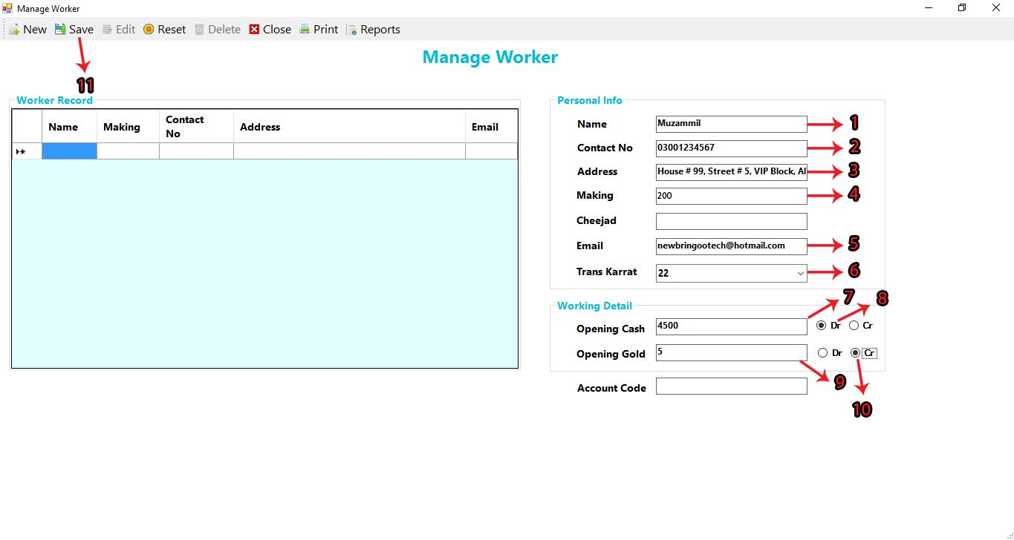
ADD WORKER
1. Enter worker’s Name. 2. Enter worker’s Contact Number. 3. Enter worker’s Address. 4. Enter worker’s Making. 5. Enter worker’s Email. 6. Enter worker’s transection karrats. 7. Enter worker’s Opening Cash. 8. Select Debit or Cradit of worker for opening cash. 9. Enter worker’s Opening Gold. 10. Select Debit or Credit of worker for opening gold.

Slide 17
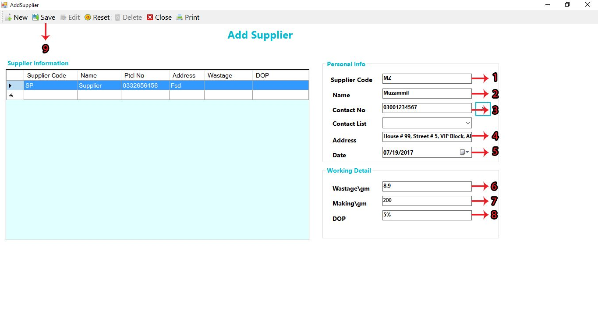
ADD SUPPLIER
1. Enter Supplier Code. 2. Enter Supplier Name. 3. Enter Supplier Contact Number. 4. Enter Supplier Address. 5. Enter Date. 6. Enter Wastage/Gram. 7. Enter Making/Gram. 8. Enter Discount on priority. 9. Click on SAVE button to save the record.

Slide 18
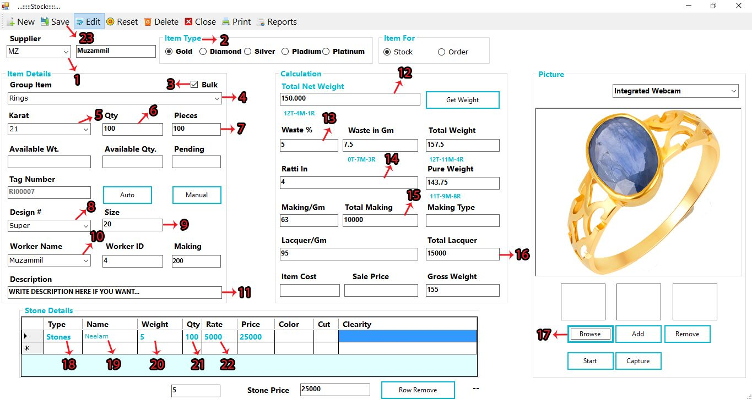
ADD STOCK
1. Select Supplier which were you added. 2. Select Item Type which you want. 3. Select Bulk if you want to add stock in bulk quantity. 4. Select group item which were You added. 5. Select Karrat of the quantity. 6. Enter Quantity of item. 7. Enter item pieces. 8. Select design number which were you added. 9. Enter Size of item. 10. Select Worker which were you added. 11. Write any type of description. 12. Enter Total net weight in gram. 13. Enter percentage of waste. 14. Enter ratti In. 15. Enter Total Making. 16. Enter Total Lacquer. 17. Select image if you want from browser button. 18. Select Stone Type. 19. Select Stone Name which were you added. 20. Enter Weight in gram. 21. Enter Quantity of an item. 22. Enter Rate of item, Price will automatically display. 23. Click on SAVE button to save the stock.

Slide 19
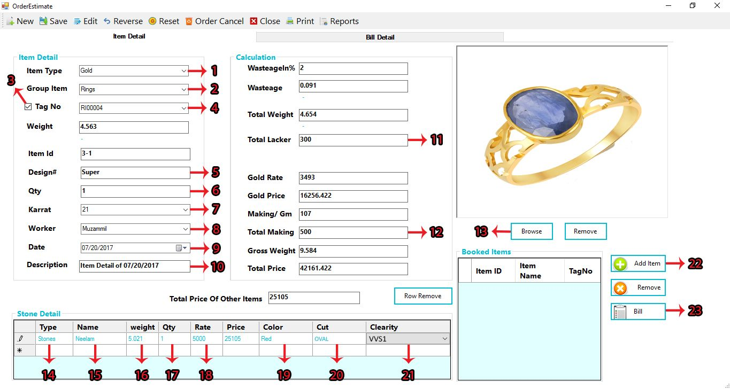
ADD ITEM DETAIL-1
1. Select Item Type. 2. Select Group Item. 3. Click on check button to select tag number which was already saved. 4. Select tag number. 5. Enter Design number. 6. Enter quantity of item. 7. Select karrat of item. 8. Select Worker Name. 9. Select Date. 10. Write description. 11. Enter Total Lacker. 12. Enter Total Making. 13. Click on browse button to select a picture. 14. Double click on it and select stone type. 15. Double click on it and select stone name which were you saved. 16. Double click on it and enter stone weight. 17. Double click on it and enter quantity of stone. 18. Double click on it and enter rate of stone. 19. Double click on it and select stone color. 20. Double click on it and select diamond cut number on stone. 21. Double click on it and select diamond clearity number on stone. 22. Click on Add Item button to save the item detail. 23. Click on Bill button to Enter Bill Detail.

Slide 20
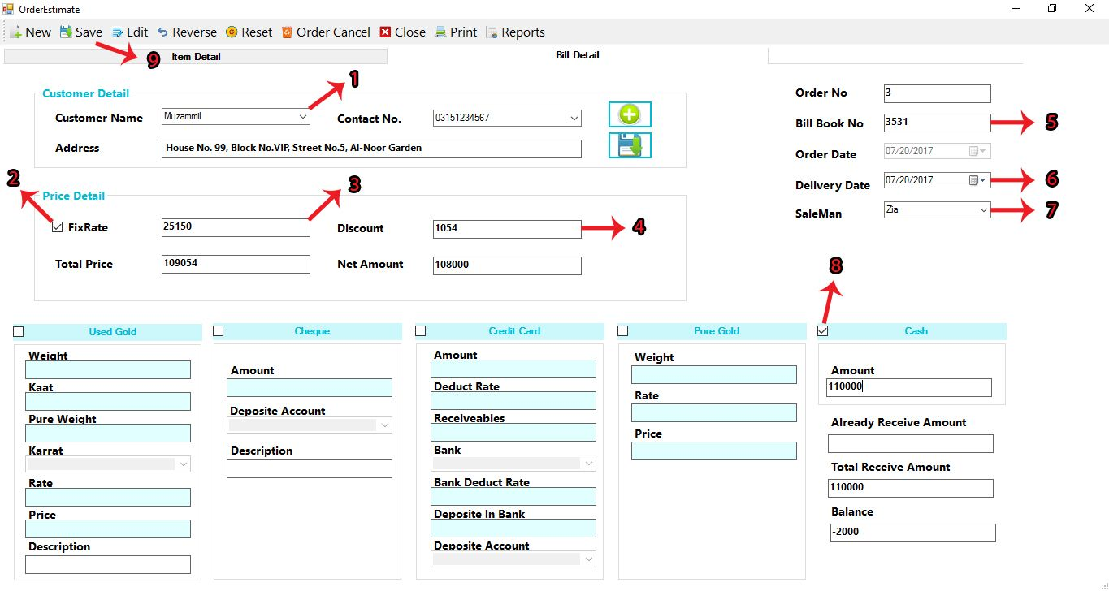
ADD BILL DETAIL-2
1. Select Customer Name which were you added. 2. Click on check button to Enter the fix rate. 3. Enter the fix rate. 4. Enter Discount from the price. 5. Enter Bill Book Number. 6. Enter Delivery Date. 7. Select Sale man. 8. Click on check button of cash or pure gold or credit card or cheque or used gold in which your customer gave you payment. 9. Click on SAVE button to save the record.

Slide 21
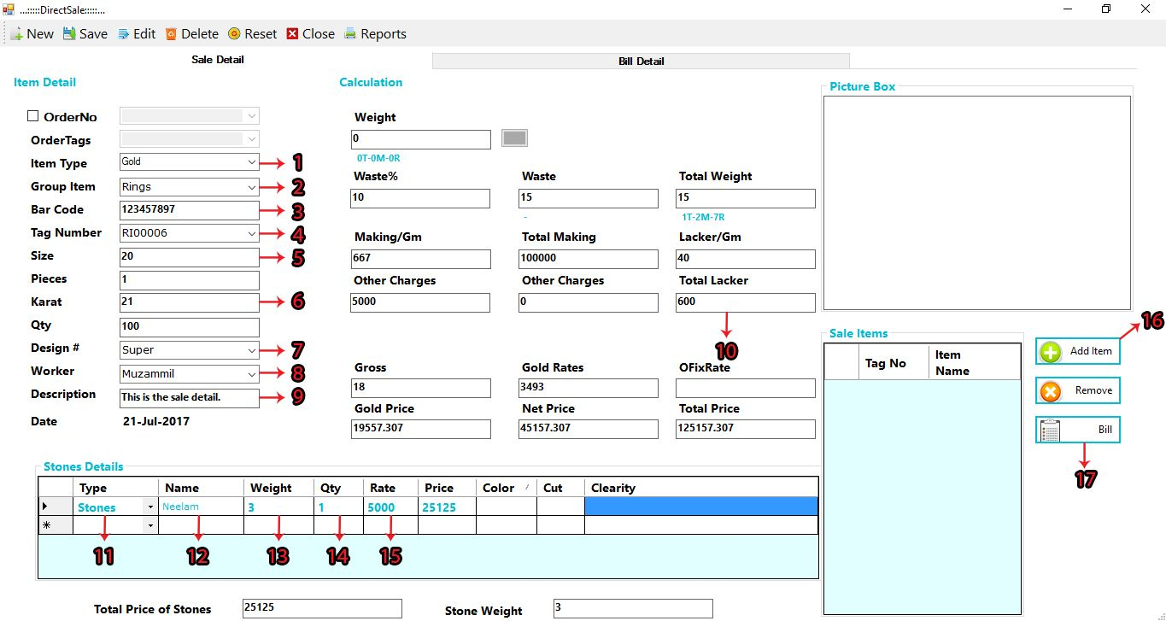
ADD SALE DETAIL-1
1. Select Item Type. 2. Select group Item. 3. Enter Bar code number. 4. Select Tag number. 5. Enter Size number. 6. Enter karrat. 7. Select design number. 8. Select Worker Name. 9. Write description. 10. Enter Total lacker. 11. Double click on it and select stone type. 12. Double click on it and select stone name. 13. Double click on it and enter stone weight. 14. Double click on it and enter stone quantity. 15. Double click on it and enter stone rate. 16. Click on Add Item button to save the record. 17. After that click on bill button to go to bill detail.

Slide 22
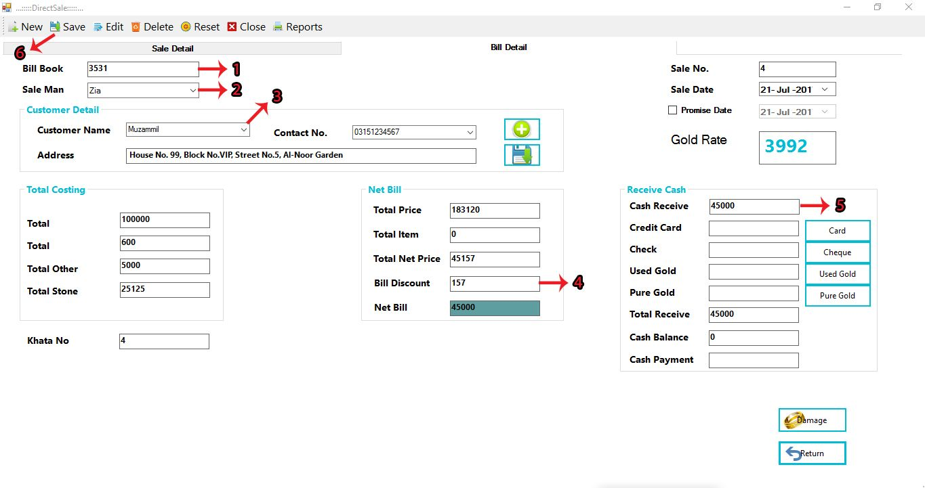
ADD BILL DETAIL-2
1. Enter Bill Book Number. 2. Select Sale man. 3. Select Customer Name.. 4. Enter Bill Discount. 5. Enter received cash. 6. Click on SAVE button to save the record.

Slide 23
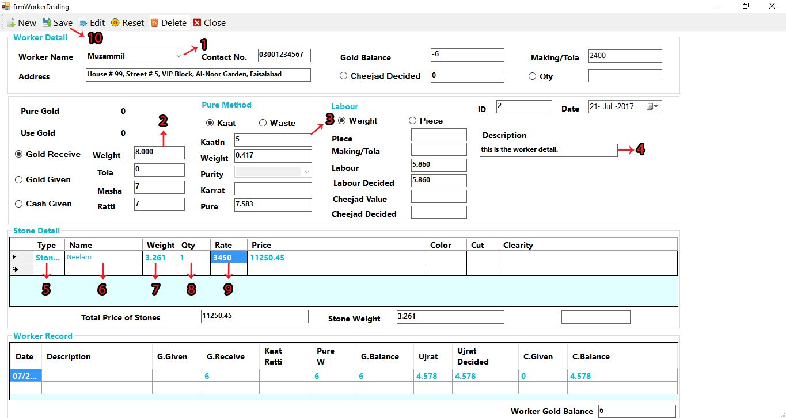
WORKER DEALING WITH KAAT-1
1. Select Worker Name. 2. Enter Weight. 3. Enter KaatIn. 4. Enter Description. 5. Double Click on it and select Stone type. 6. Double Click on it and select Stone name. 7. Double Click on it and enter Stone weight. 8. Double Click on it and enter Stone quantity. 9. Double Click on it and enter Stone rate. 10. Click on SAVE button to save the record.

Slide 24
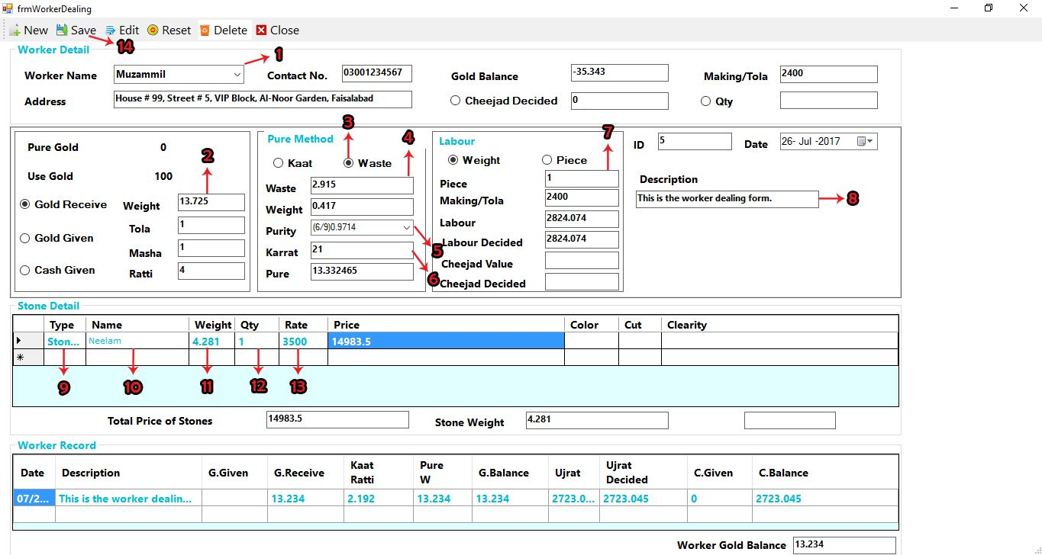
WORKER DEALING WITH WASTE-2
1. Select Worker Name. 2. Enter Weight. 3. Select Waste. 4. Enter Waste. 5. Select Purity. 6. Enter Karrat. 7. Enter Piece. 8. Enter Description. 9. Double Click on it and select Stone type. 10. Double Click on it and select Stone name. 11. Double Click on it and enter Stone weight. 12. Double Click on it and enter Stone quantity. 13. Double Click on it and enter Stone rate. 14. Click on SAVE button to save the record.

Slide 25
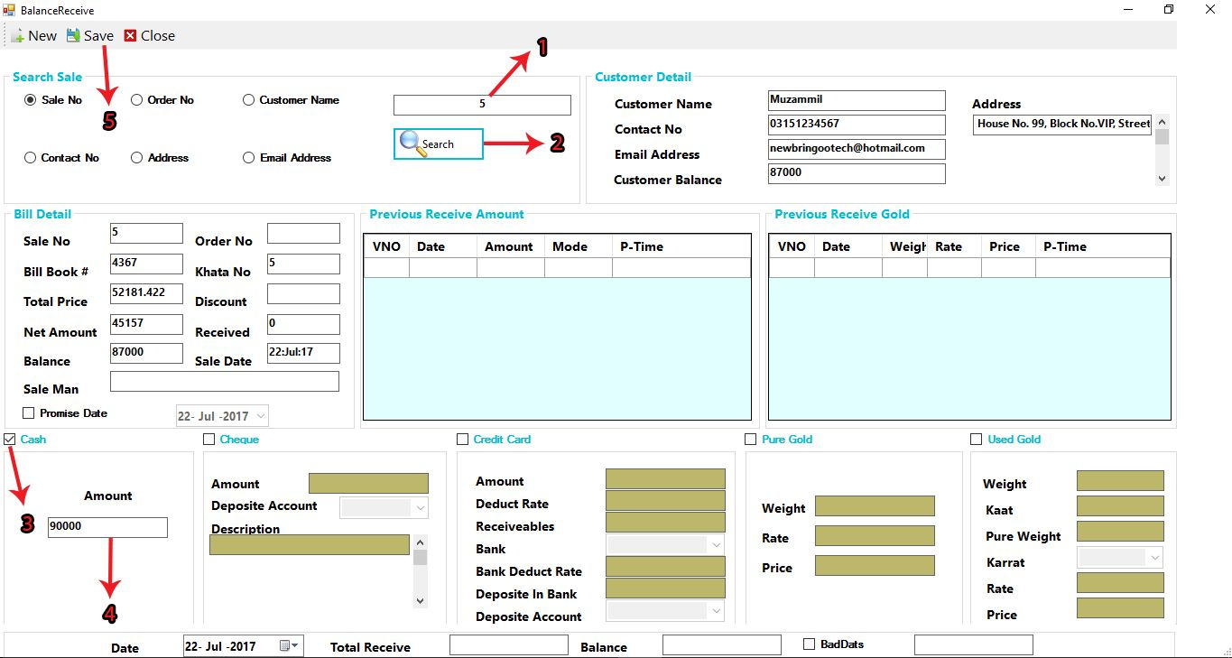
BALANCE RECEIVE VOUCHER
1. Enter Sale number in which cash is not received. 2. Click on this button to search sale which is already saved by you. 3. Click on check box to enable the field. 4. Enter Received Amount. 5. Click on SAVE button to save the record.

Slide 26
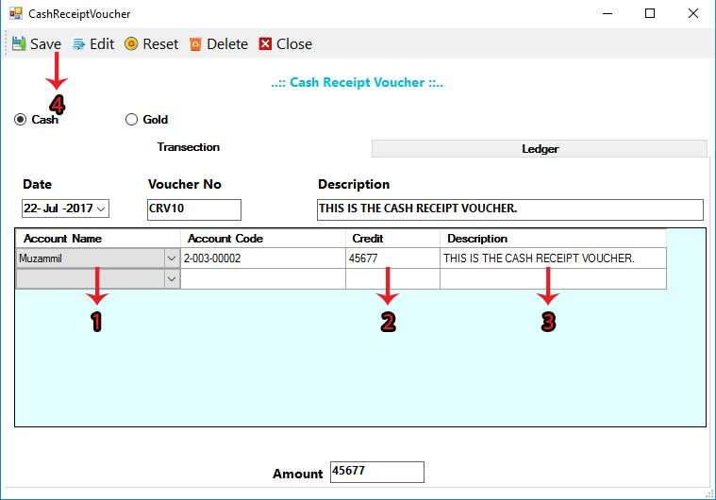
CASH RECEIPT VOUCHER
1. Double Click on it and select account name. 2. Double Click on it and enter credit. 3. Double Click on it and write the description. 4. Click on SAVE button to save the record.

Slide 27
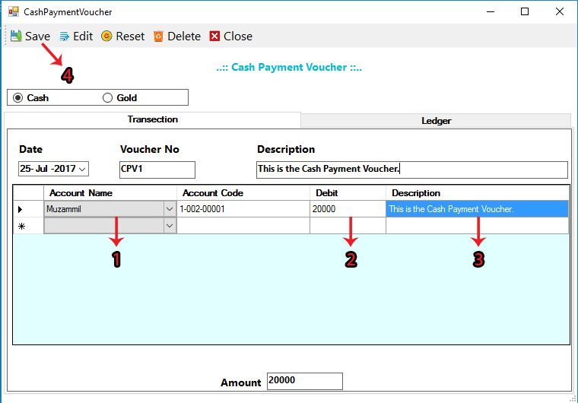
CASH PAYMENT VOUCHER
1. Double Click on it and select account name. 2. Double Click on it and enter debit. 3. Double Click on it and write the description. 4. Click on SAVE button to save the record.

Slide 28
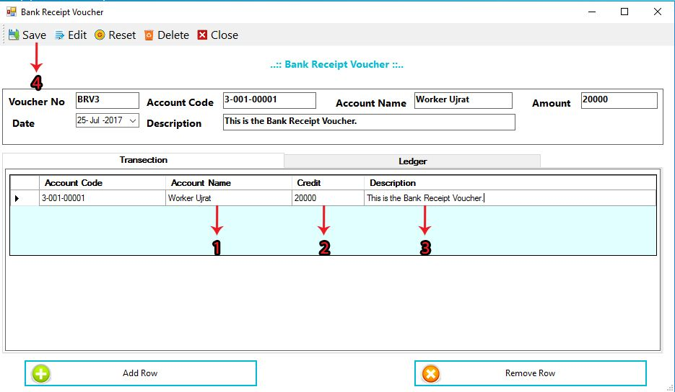
BANK RECEIPT VOUCHER
1. Click on account name and select account name. 2. Double click on it and enter credit. 3. Double click on it and write description.

Slide 29
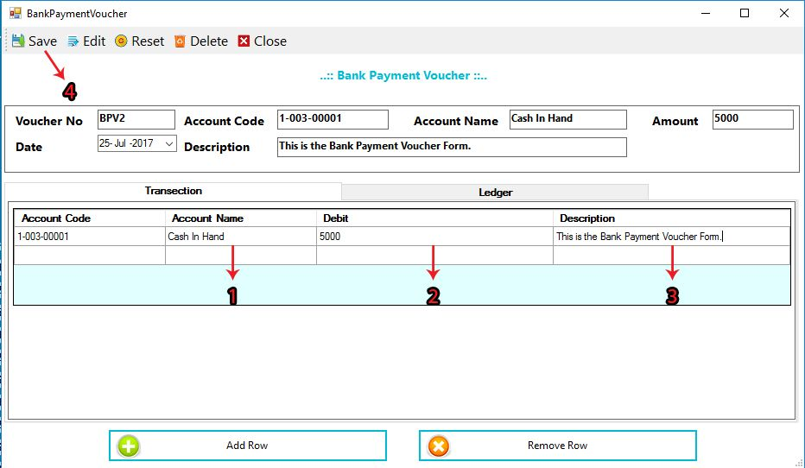
BANK PAYMENT VOUCHER
1. Click on account name and select account name. 2. Double click on it and enter debit. 3. Double click on it and write description.

Slide 30
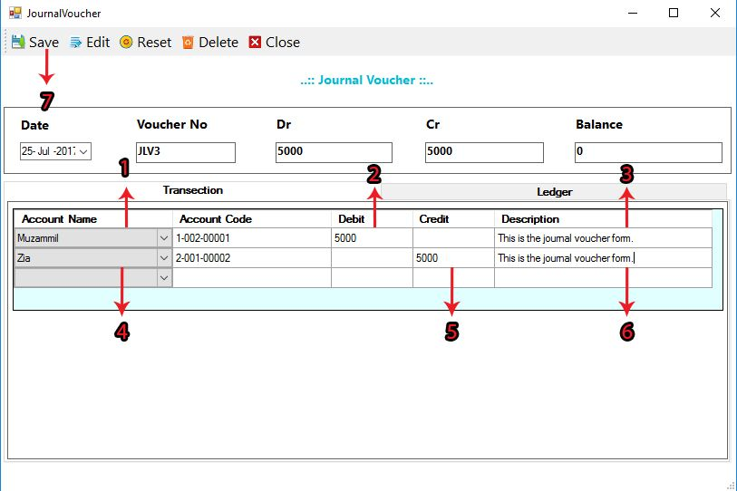
JOURNAL VOUCHER
1. Select Account Name. 2. Double click on it and enter debit. 3. Double click on it and write description. 4. Select Account Name. 5. Double click on it and enter credit. 6. Double click on it and write description. 7. Click on SAVE button to save the record.

Slide 31
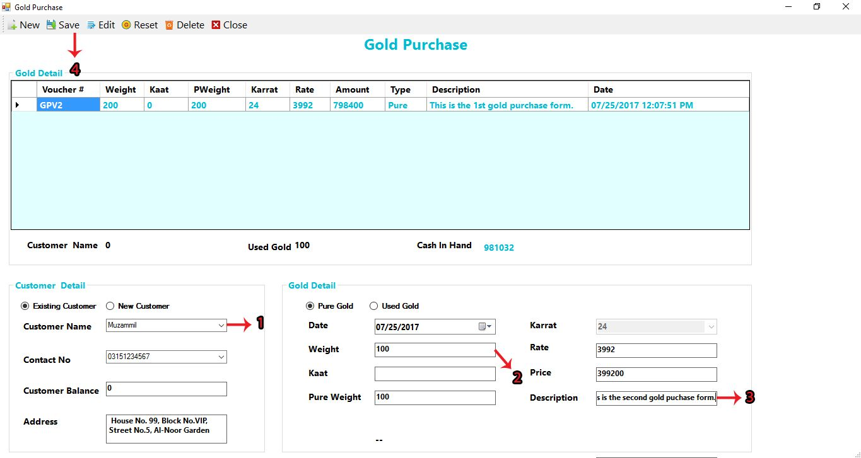
GOLD PURCHASE
1. Select Customer Name. 2. Enter Weight of pure gold. 3. Write Description. 4. Click on SAVE button to save the record.

Slide 32
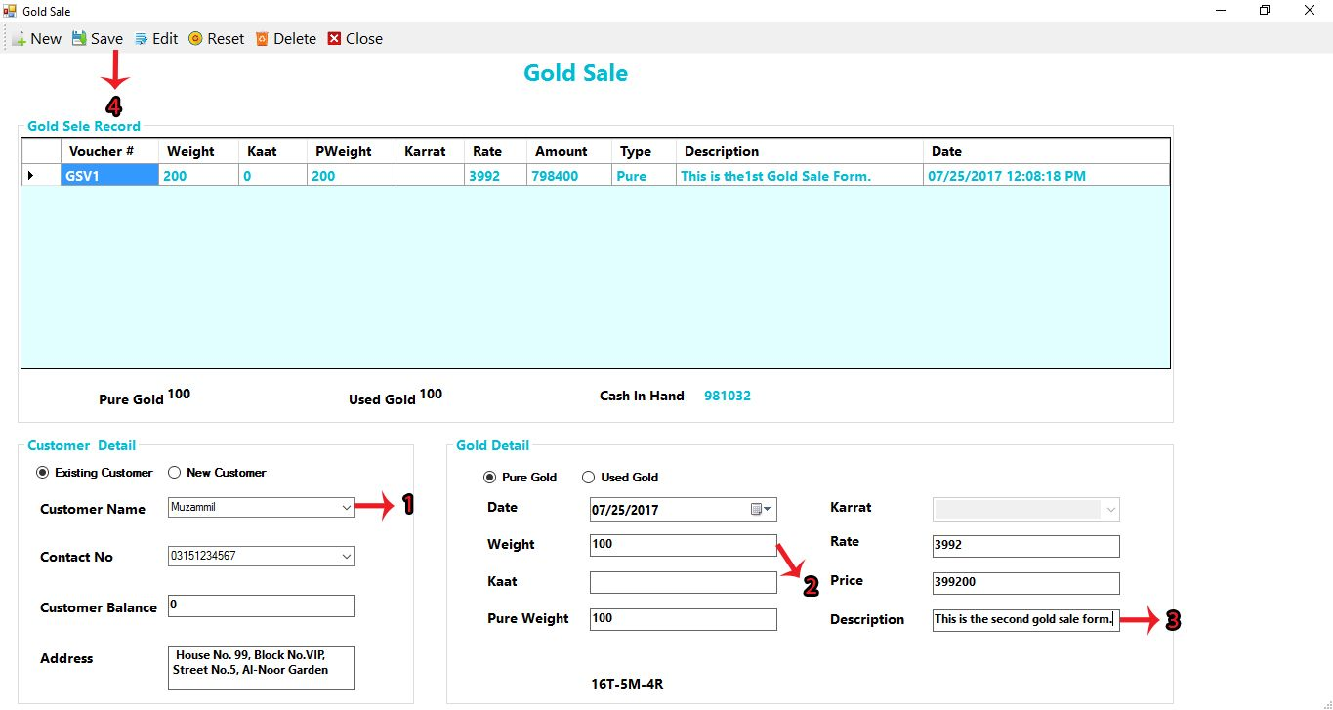
GOLD SALE
1. Select Customer Name. 2. Enter Pure Weight. 3. Write description. 4. Click on SAVE button to save the record.

Slide 33
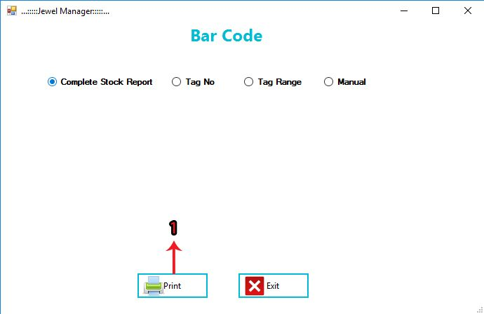
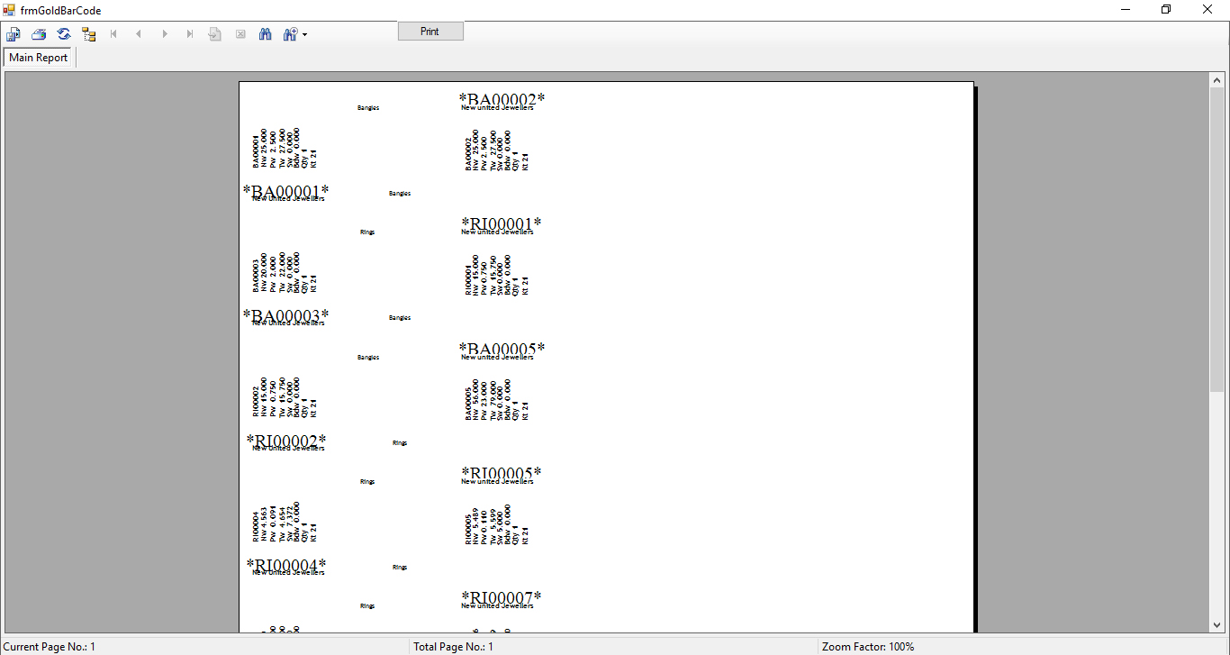
COMPLETE STOCK REPORT-1

Slide 34
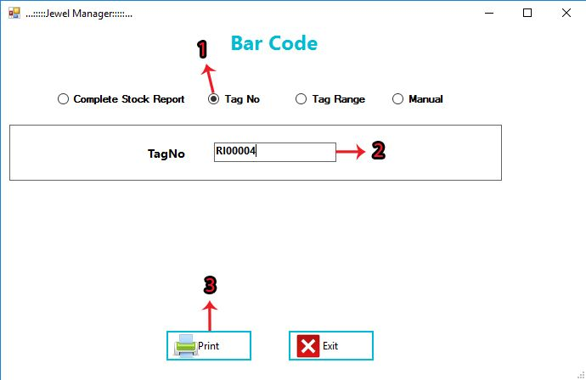
TAG NUMBER-2
1. Click on Tag number. 2. Enter Tag number which were saved by you. 3. Click on Print button to print the Tag number.

Slide 35
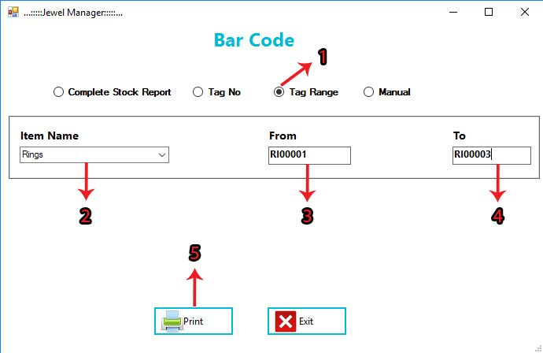
TAG RANGE-3
1. Click on Tag Range. 2. Select Item Name. 3. Enter start of Tag Number. 4. Enter End of Tag Number 5. Click on PRINT button to print range of tag numbers.

Slide 36
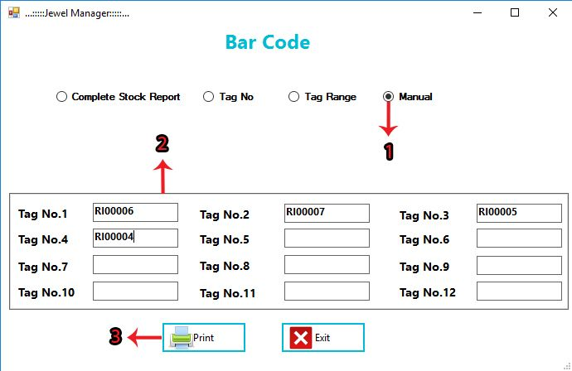
MANUAL-4
1. Click on Manual. 2. Enter random tag number to print tags. 3. Click on PRINT button to print the tag numbers.

Slide 37
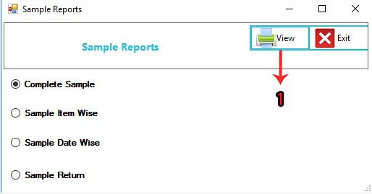
Complete Sale Report
Here user can generate complete sale report by clicking on view button.
User click on sample reports tab and then different type of reports are available to user

Slide 38
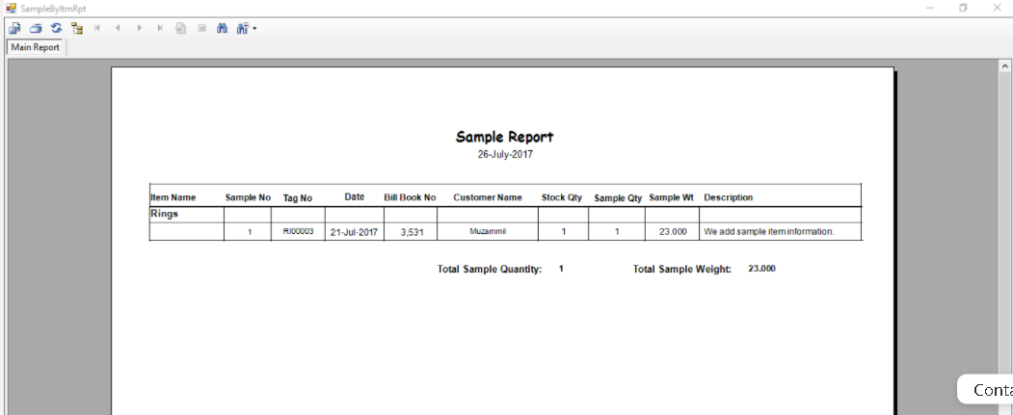

Slide 39
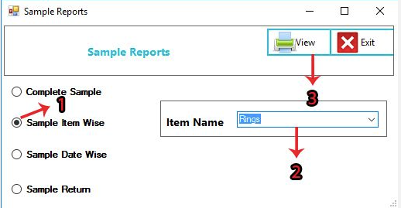
Sample Item Wise
User select sample item wise option.
User then enter item name.
User then click on view tab.

Slide 40
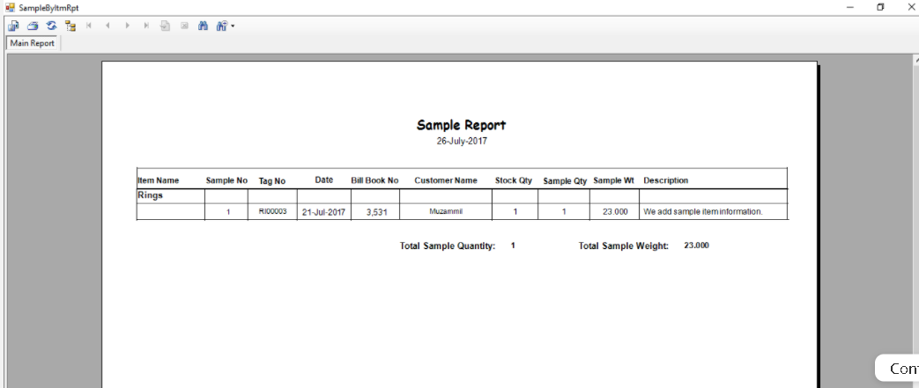

Slide 41
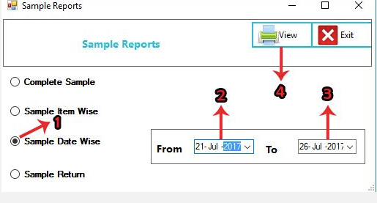
Sample Data Wise
User select sample data wise option.
User then select dates.
User then click on view tab.

Slide 42


Slide 43
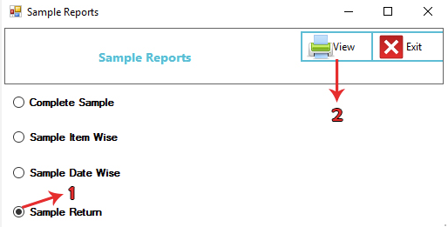
Sample Return
User select sample return option.
User then click on view tab.

Slide 45
Detail Stock Report
User click on detail stock report panel.
User then select complete stock option.
User then select item type and then click on view tab to generate a report.

Slide 46
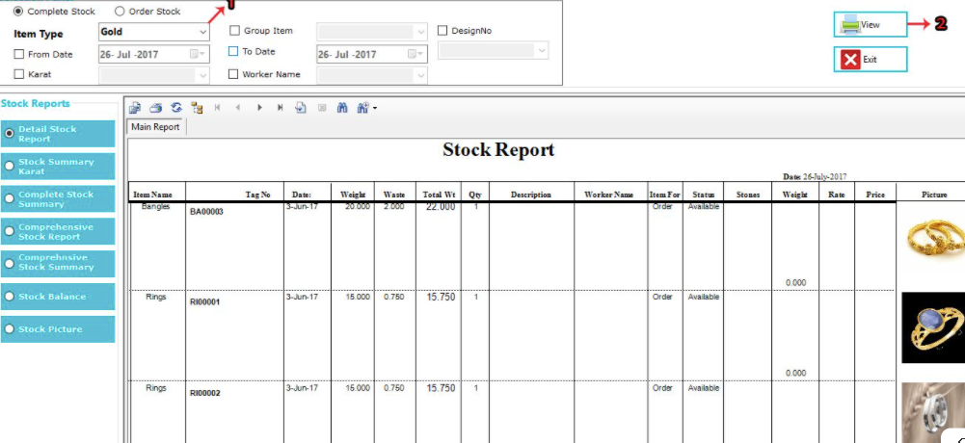

Slide 47
Stock Summary Karat
User click on detail stock summary karat panel.
User then click on view tab to generate a report.
A report is display Infront of user.

Slide 48
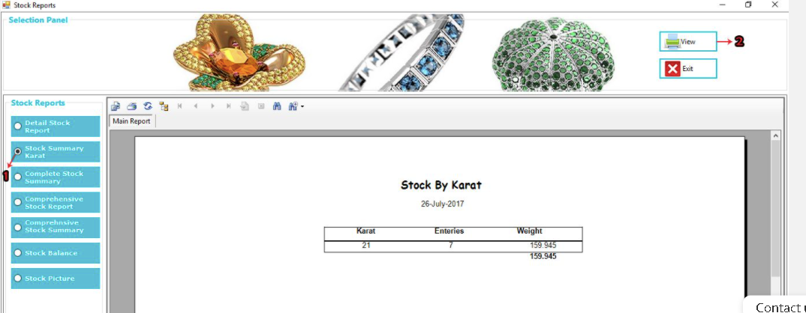

Slide 49
Complete Stock Summary
User click on complete stock summary panel.
User then select start and end dates.
User then click on view tab to generate a report.
A report is display Infront of user.

Slide 50
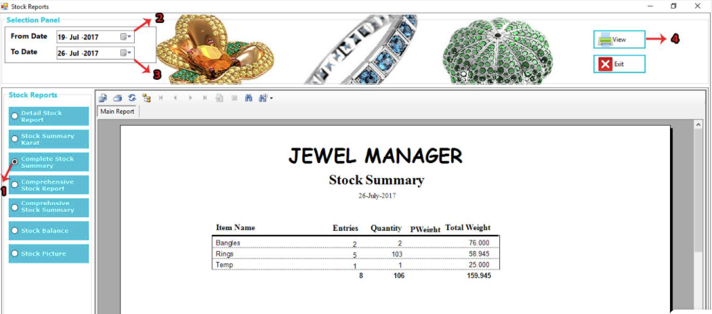

Slide 51
Comprehensive Stock Report
User click on comprehensive stock report panel.
User then select start and end dates.
User then click on view tab to generate a report.
A report is display Infront of user where item name, previous balance, stock in, stock out, and balance are present.

Slide 52
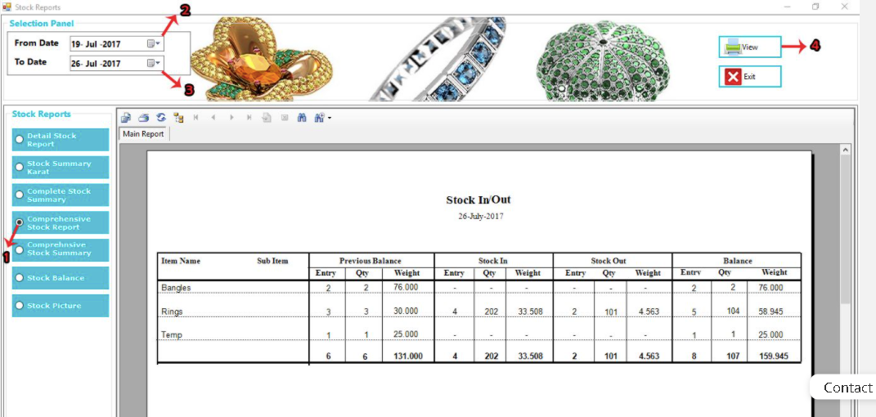

Slide 53
Comprehensive Stock Summary
User click on comprehensive stock summary panel.
User then click on view tab to generate a report.
A report is display Infront of user where item name and total balance are present.

Slide 54
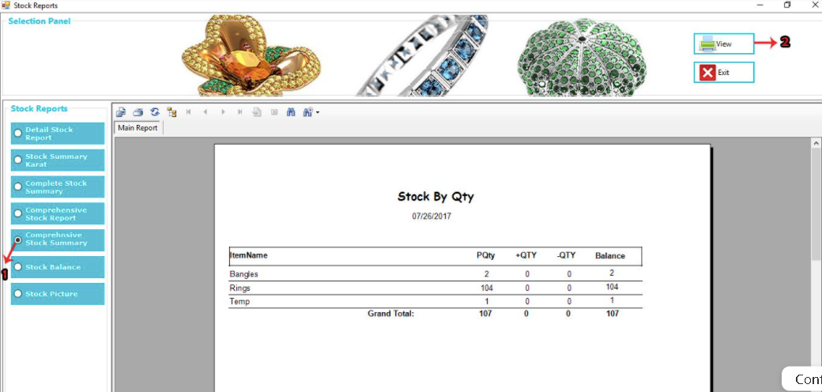

Slide 55
Complete Sale
User click on complete sale tab.
User select complete sale option.
User then select item name.
User then click on view tab.
Report is display to the user where item detail, customer name, bill book no, tag no, item name, date, weight, rate, and balance are present.

Slide 56
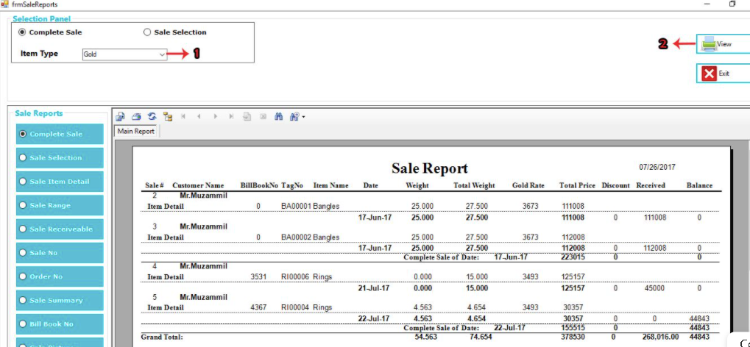

Slide 57
Sale Selection
User click on sale selection tab.
User select sale selection option.
User then select item name.
User then click on view tab.
Report is display to the user where item detail, customer name, bill book no, tag no, item name, date, weight, rate, and balance are present.

Slide 58
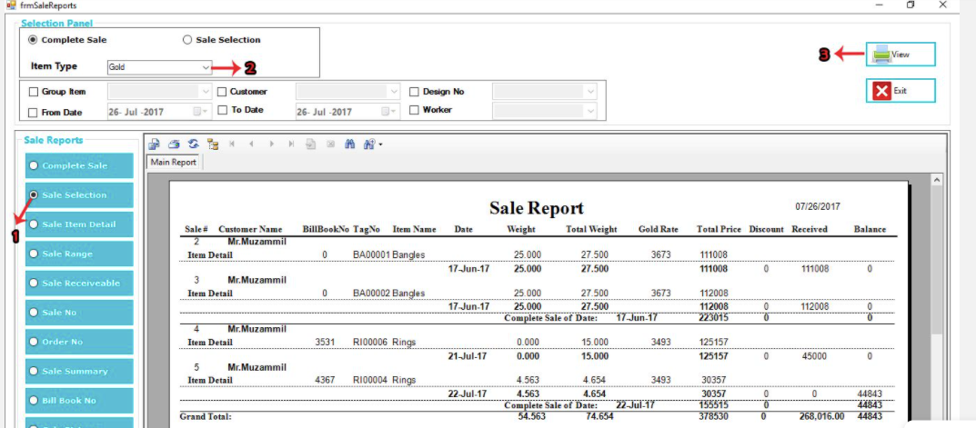

Slide 59
Sale Item Detail
User click on sale item detail tab.
User select item type option.
User select start and end date.
User then click on view tab.
A report is display to the user where item detail, customer name, bill book no, tag no, item name, date, weight, rate, and balance are present.

Slide 60


Slide 61
Sale Range
User click on sale range tab.
User define the range.
User then click on view tab.
A report is display to the user in context of range like user select 2 to 4 then result display according to user selection where item detail, customer name, bill book no, tag no, item name, date, weight, rate, and balance are present.

Slide 62


Slide 63
Sale Summary
User click on sale summary tab.
User then select date.
User then click on view tab.
A report is display in front of user according to choosing of user date.

Slide 64


Slide 65
Sale Comprehensive
User click on sale comprehensive tab.
User then select date.
User then click on view tab.
A comprehensive sale report display to the user according to the user particular selected date where item name, balance and stock out are present.

Slide 66


Slide 67

Gold Sale Purchase By Customer
User select customer option.
User then select customer name.
Click on view tab.
A report is display to the user according to customer name where sale purchase details are available in context of that customer.

Slide 68


Slide 69

Gold Sale Purchase Summary
User select customer summary option.
Click on view tab.
A report is display to the user according to customer name where sale purchase details are available in context of that customer.

Slide 70


Slide 71

Gold Sale Purchase Date
User select date option.
User then select start and end date.
Click on view tab.
A report is display to the user according to date selected where sale purchase details are available in context of that customer.

Slide 72


Slide 73

Gold Sale Purchase Report
User select gold balance option.
User then select start and end date.
Click on view tab.
A report is display to the user according to gold balance where pure gold balance and used gold balance is displayed.

Slide 74


Slide 75

Worker
User select worker option.
User then select worker name.
User then click on print tab.
A worker report is display where worker given and receive detail is available.

Slide 76


Slide 77

Worker Summary
User select worker summary option.
User then click on print tab.
A report is display where selected worker summary is present such as worker name, given gold, receive gold, ujraat and cash balance are available.

Slide 78


Slide 79

Worker List
User select worker list option.
User select worker summary option.
A report is display where selected worker name, address, email and contact are available.

Slide 80


Slide 81

Account Ledger
User select account ledger option.
User then choose head account, parent name and child account.
User then select start and end date .
Click on view tab.
A report is generated where account ledger information is present.

Slide 82


Slide 83

Gold Ledger
User select gold ledger option.
User then choose head account, parent name and child account.
User then select start and end date .
Click on view tab.
A report is generated where gold ledger information is present such as general info, cash and gold.

Slide 84


Slide 85

Parent Report
User select parent report option.
User then choose head account and parent name.
User then select start and end date .
Click on view tab.
A report is generated where account name, account balance and balance are present.

Slide 86


Slide 87

Head Report
User select head report option.
User then choose head account and parent name.
User then select start and end date .
Click on view tab.
A report is generated where group name, account balance and balance are present.

Slide 88


Slide 89

Comprehensive Ledger
User select comprehensive ledger option.
User then choose head account, child account and parent name.
User then select start and end date .
Click on view tab.
A report is generated where account name, account balance and balance are present.

Slide 90


Slide 91

Trial Balance
User select trial balance option.
Click on view tab.
A report is generated where child account name is present.

Slide 92


Slide 93

Tag History
User select item name.
User select tag no.
User then click on view tab.
Tags history is generated and display on the screen.

Slide 94


Slide 95

Customer Report
User click on reports and select customer reports.
Customers report is generated where customers name, address, mobile no, city and balance are present.

Slide 96


Slide 97

Date
User select date option.
Then user select a date.
User then click on view tab.
Report is generated according to selected date.

Slide 98


Slide 99

Date Range
User select date range option.
User then select start and end date.
User then click on view tab.
A report is generated where records are present from start date to end date.

Slide 100


